Slide 1
Never/Sometimes/Always Good Rating Scale (Activities)
Gemma Arnold

Slide 2
Respondent Information (please type or write below)
How old are you?
Are you in education or training?
Are you employed?
Do you have a diagnosis of any of the following? (please tick)
How would you describe your speech, language, and communication needs?
Autism Spectrum Disorder (ASD) | Learning Difficulties (Mild, Moderate, Severe, or Profound & Multiple)
Speech, Language, & Communication Needs (SLCN) | Social, Emotional, Mental Health Needs (SEMH)
Specific Learning Difficulties (e.g. Dyslexia) | Multi - Sensory impairment
Hearing Impairment | Other

Slide 3
Please tell us where you live (please tick)
Canterbury
Dartford
Gravesham
Maidstone
Sevenoaks
Shepway
Thanet
Tonbridge & Malling
Tunbridge Wells
Dover
Swale

Slide 4
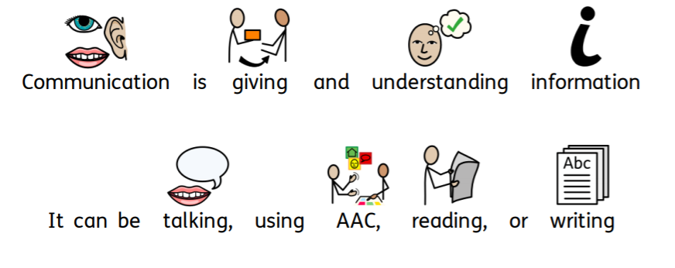
What is communication?

Slide 5
Core Activity

Slide 6
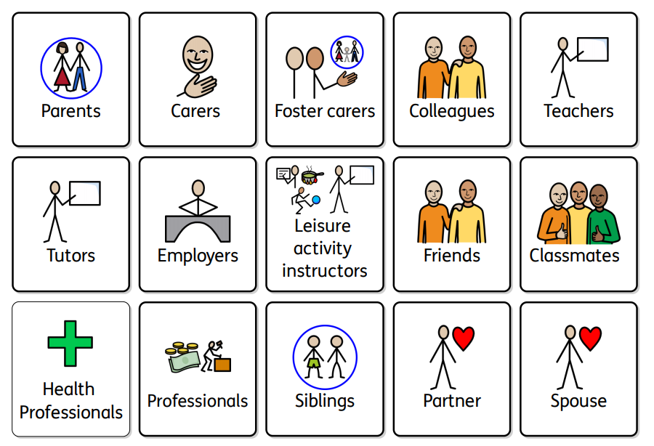
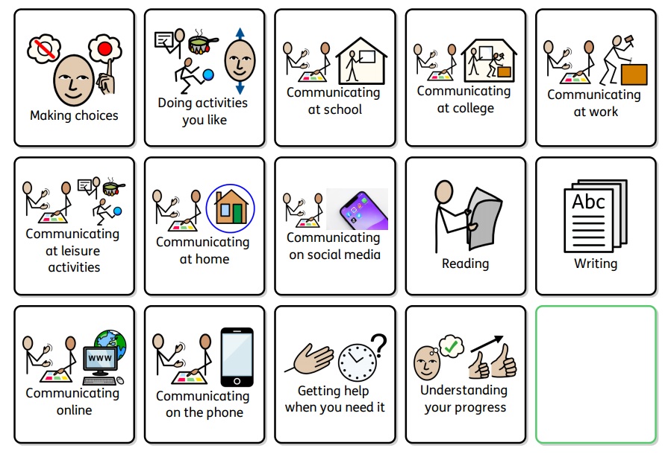
Core vocabulary

Slide 7
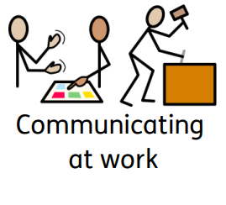
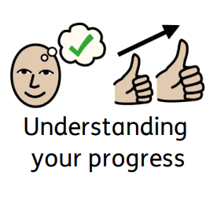
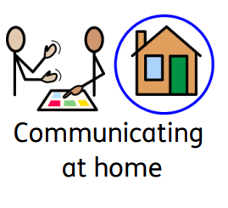
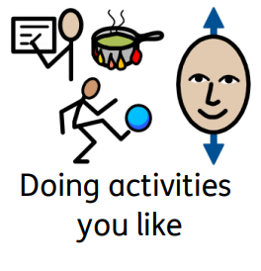
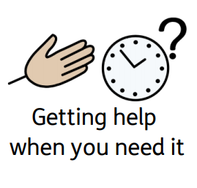
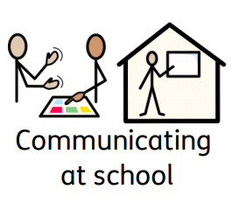
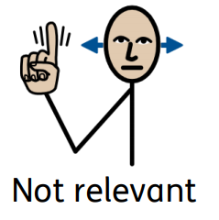
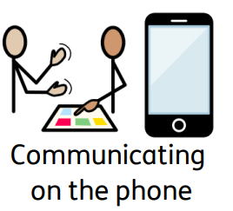
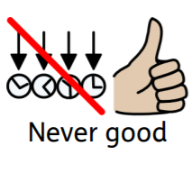
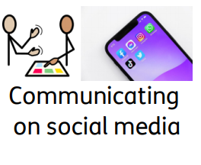
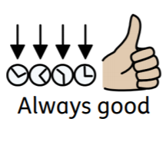
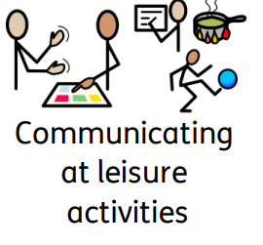
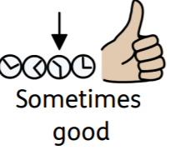

Slide 8
3 things from the Core Activity that would make things better (please write or type below)
1.
2.
3.

Slide 9
Extension Activities

Slide 10
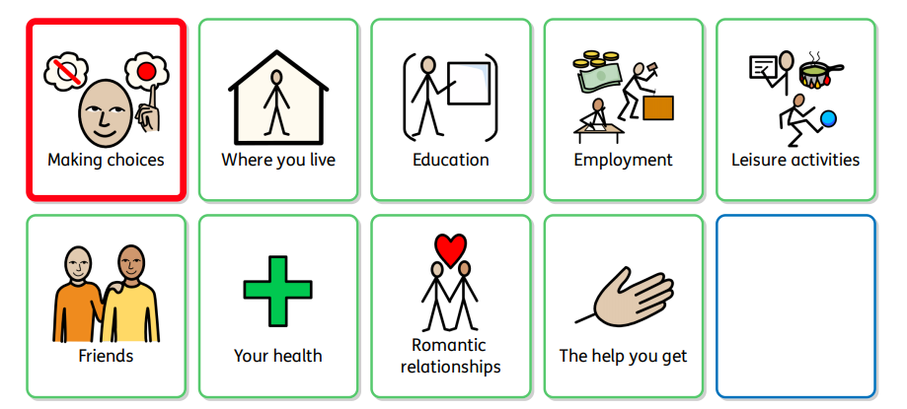
Making Choices

Slide 11
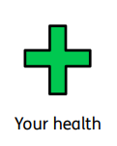
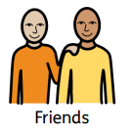
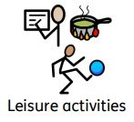

Slide 12
Communicating at school/work/college

Slide 13
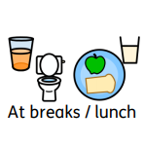
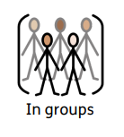

Slide 14
Communicating on social media

Slide 16
Reading

Slide 17
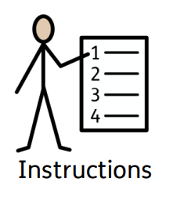
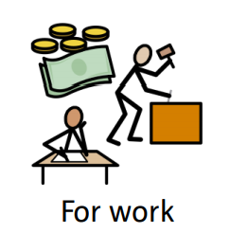
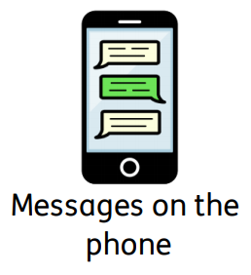
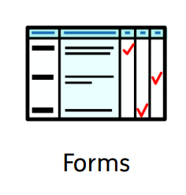

Slide 18
Writing

Slide 19
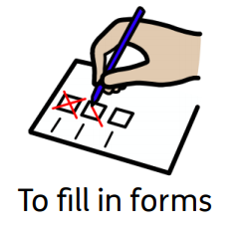
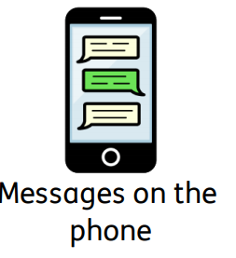
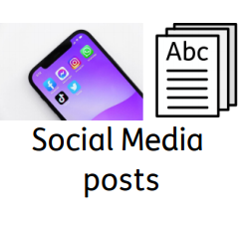

Slide 20
Please save your rating scales and return to Gemma@bettercommunication.org.uk

